Slide 1
Project 2 (P170)
Hotel Rating Classification

Slide 2
Business Objective
Here our objective is to classify the review received and monitor the same.
As People frequently or always read reviews before booking a hotel.
This statistic suggests that customer reviews play an important role in the Hospitality sector.
When it comes to booking a hotel, it serves as a reliable source of information about the hotel experience, for a potential customer.
Sentiment Analysis (SA) of hotel reviews is gaining more importance in this context.
Every review portrays certain sentiments either positive or negative which define the hotel’s reputation.
The technique of capturing this polarity from a collection of reviews (dataset) applying Natural Language Processing (NLP)
And Machine Learning (ML) to identify, adapt and analyze customers’ perceptions about the services describes Sentimental Analysis.
This type of examination is also called Opinion Mining or Emotional AI.

Slide 3
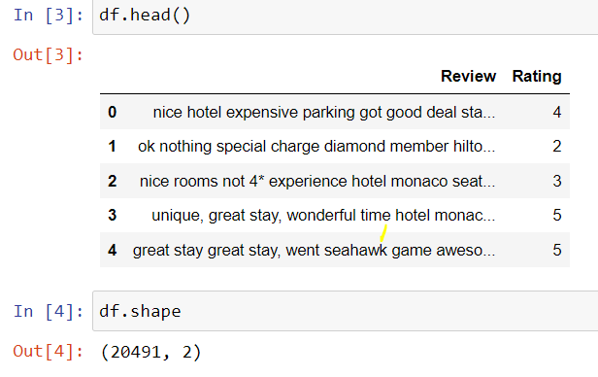
Agenda 1 – EDA
We have total of 20491 customer review for the Hotel that will be part of this analysis.

Slide 4
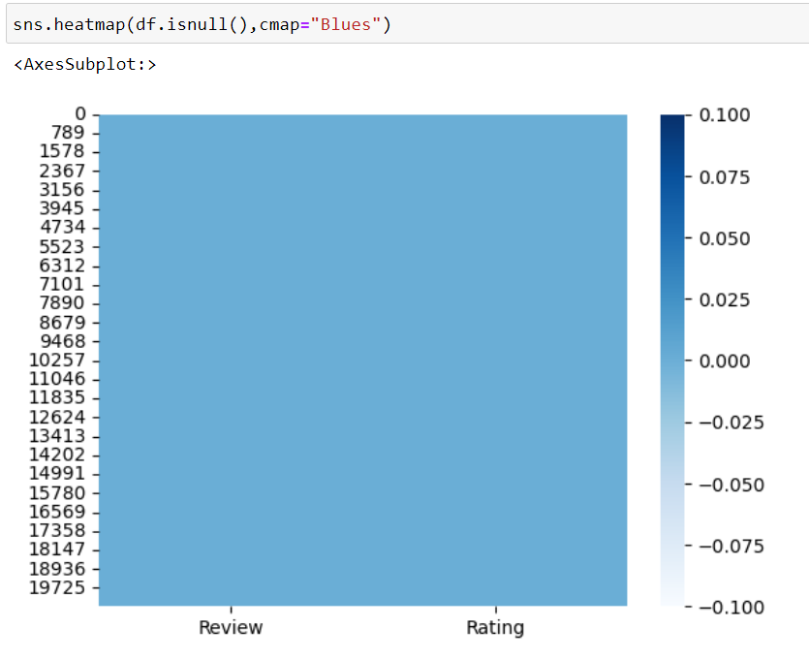
Agenda 1 – EDA
There are Zero missing or null values with no duplicates and the data type are appropriate.

Slide 5
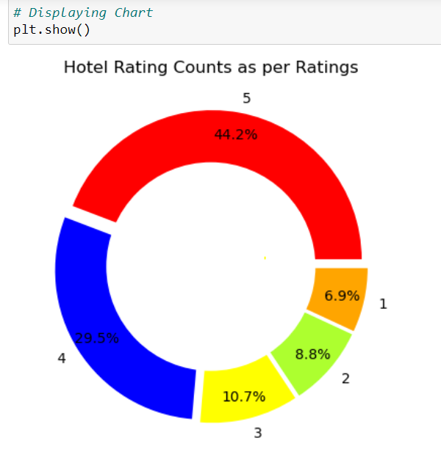
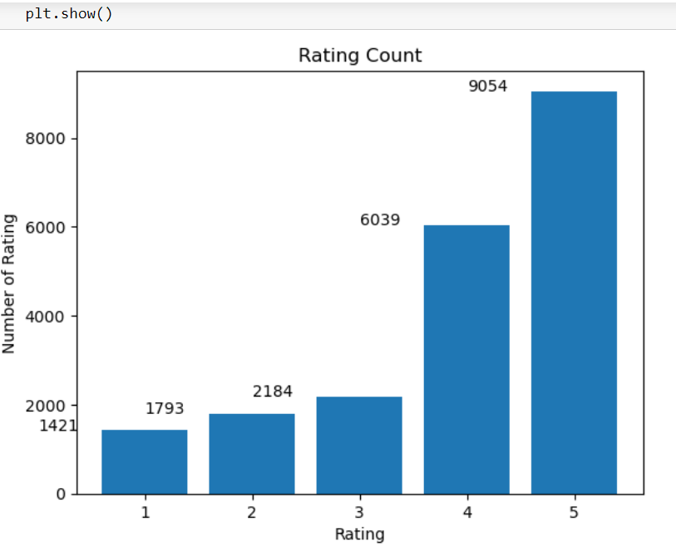
Agenda 1 – EDA
Comparing the overall rating around 45 % (9054) of the people have rated the hotel with 5 rating which gives us a positive note on the hotel and customer on an average feel good about the same.

Slide 6
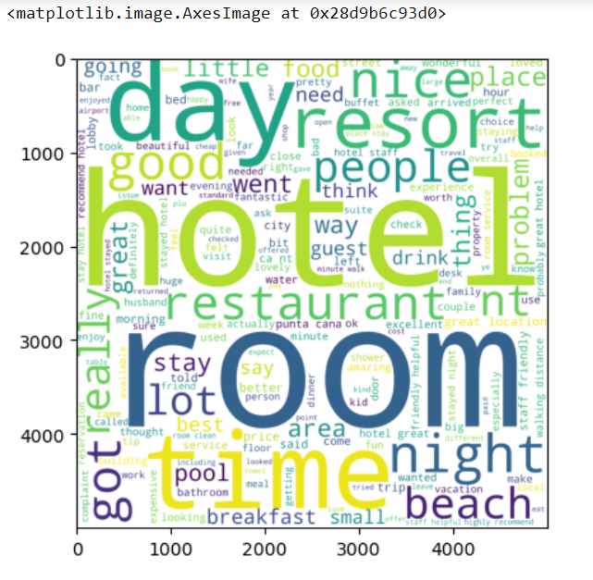
Agenda 1 – EDA
Word cloud will which allows us to visualize the high frequency words which are part of the review.
Words Like room, time, day etc. are used more frequently

Slide 7
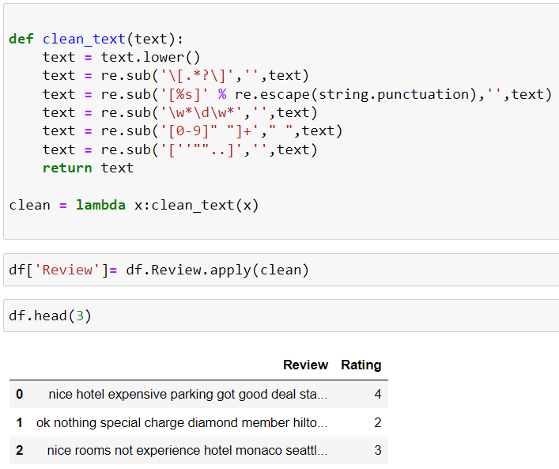
Agenda 1 – EDA
As part of Data Preprocessing, we performed the below actions
Converting the entire text to Lowercase.
removes brackets.
removal of punctuation.
removal of numbers etc.

Slide 8
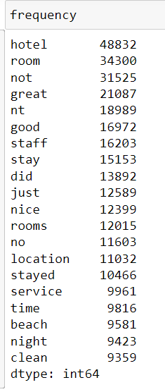
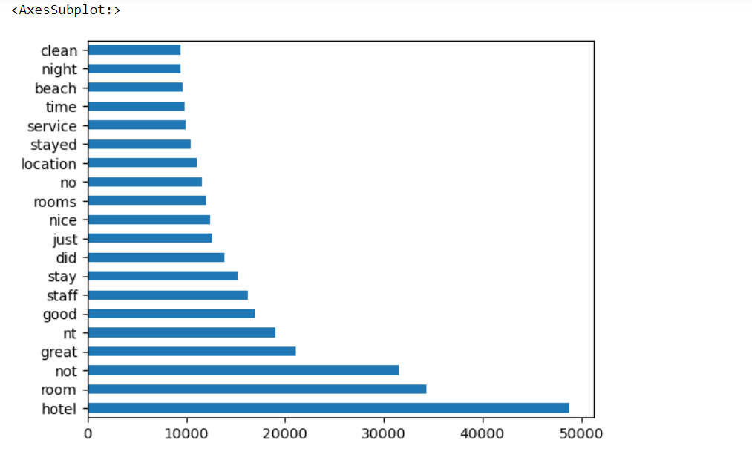
Agenda 1 – EDA
Frequency count of words before stop word removal.

Slide 9
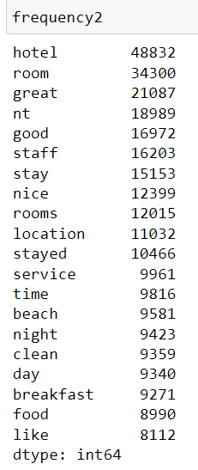
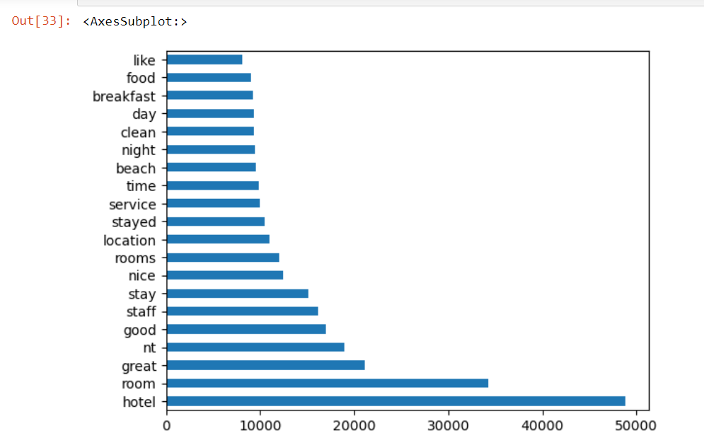
Agenda 1 – EDA
Frequency count of words After stop word removal.
We can notice words like not, no, did etc. have been removed.

Slide 10
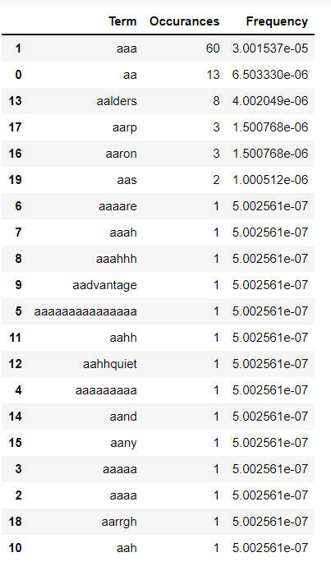
Agenda 1 – EDA
We have applied Count vectorizer and got the top 10 words with their frequency.

Slide 11
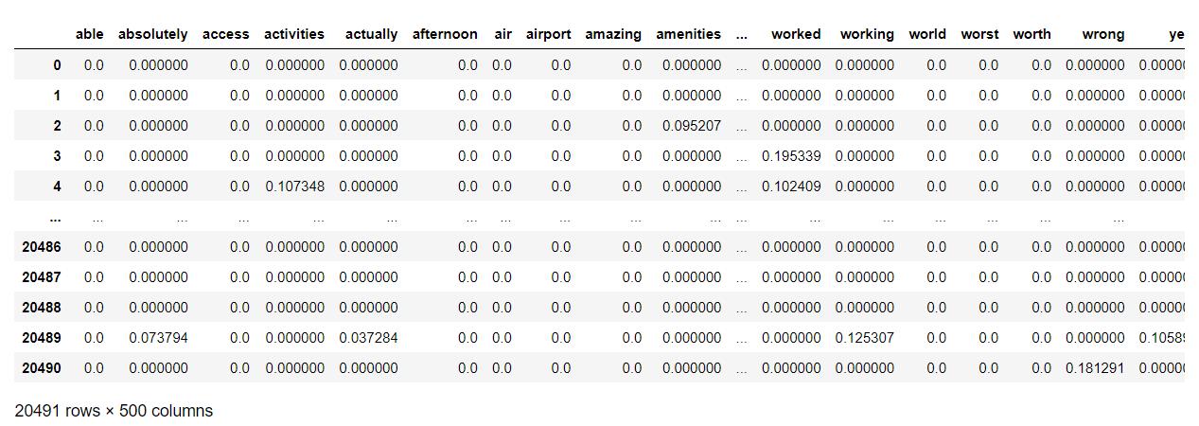
Agenda 1 – EDA
We have applied TFIDF and get top 500 features.

Slide 12
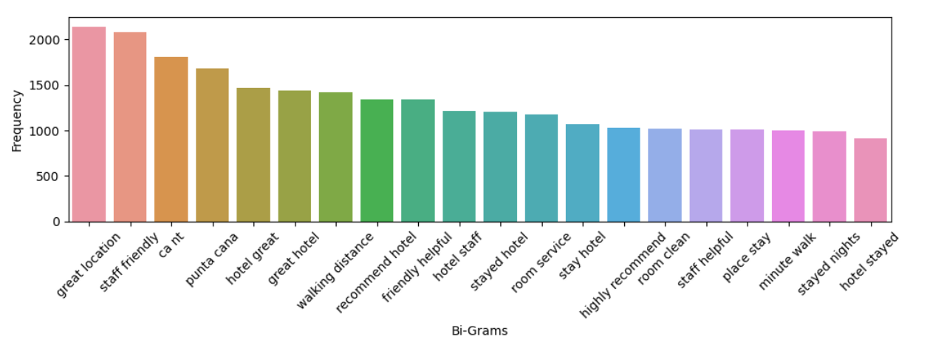
Agenda 1 – EDA
Using N-Gram we have got the top 20 Bigram in the text which can be useful for the review analysis and knowing the context of words which customers are using frequently.

Slide 13
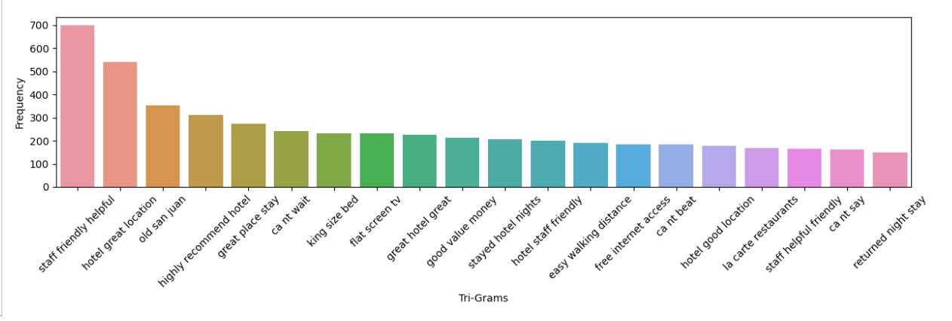
Agenda 1 – EDA
.Using N-Gram we have got the top 20 Trigram in the text which can be useful for the review analysis and knowing the context of words which customers are using frequently.

Slide 14
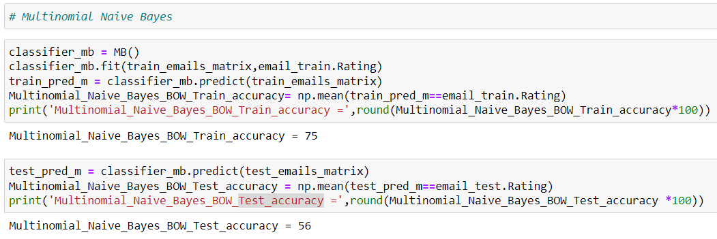
Agenda 2 – Model Building
Model 1 Multinomial Naive Bayes classification using BOW
Train_accuracy – 75%
Test_accuracy – 56%

Slide 15
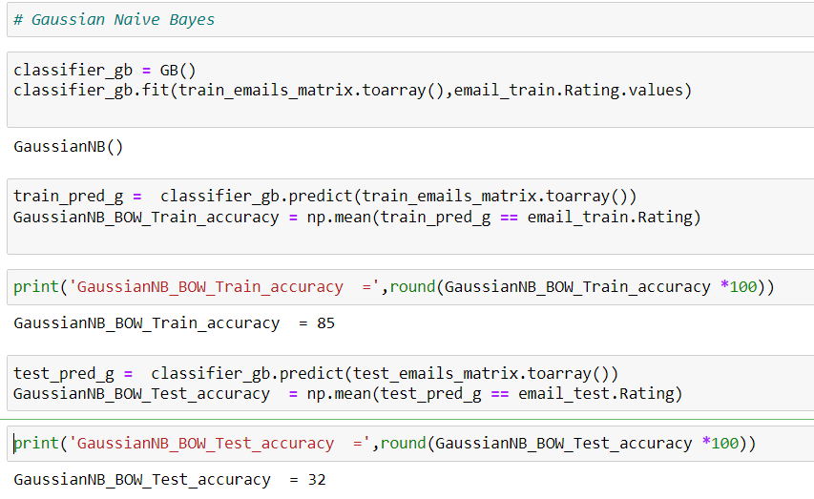
Agenda 2 – Model Building
Model 2 Gaussian Naive Bayes classification using BOW
Train_accuracy – 85%
Test_accuracy – 32%

Slide 16
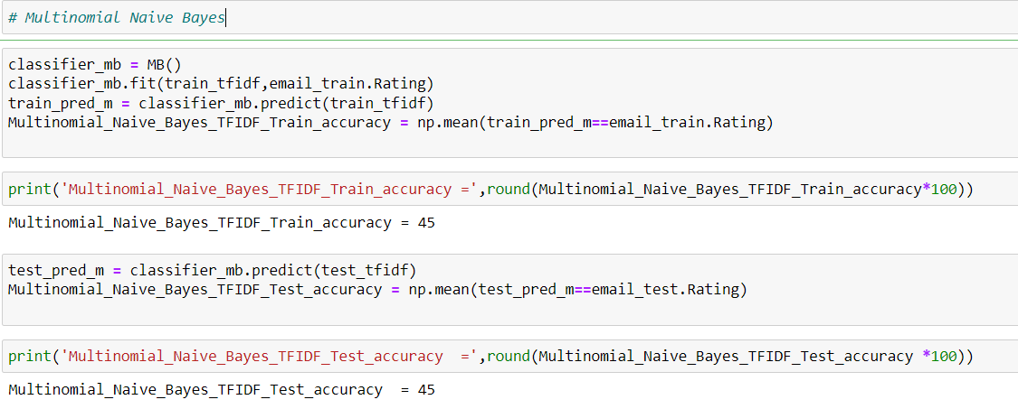
Agenda 2 – Model Building
Model 3 Multinomial Naive Bayes classification using TFIDF
Train_accuracy – 45%
Test_accuracy – 45%

Slide 17
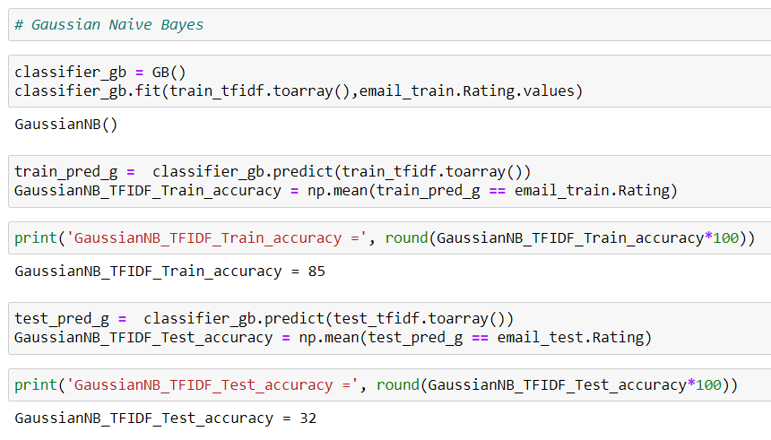
Agenda 2 – Model Building
Model 4 Gaussian Naive Bayes classification using TFIDF
Train_accuracy – 85%
Test_accuracy – 32%

Slide 18
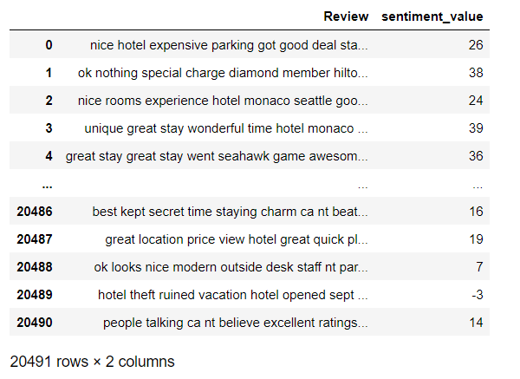
Agenda 2 – Model Building
Built Emotion Mining model using Spacy / afinn library
And these are the respective sentiment_value

Slide 19
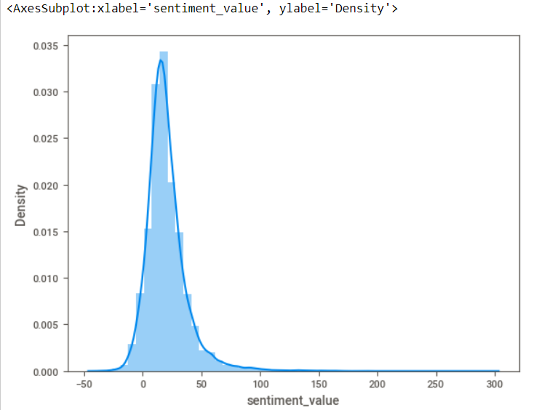
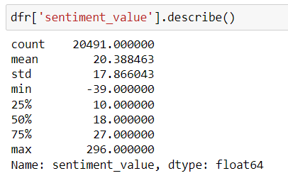
Agenda 2 – Model Building
Even with Emotion Mining we get the inference that majority of the customers are happy and have positive review about the hotel

Slide 20
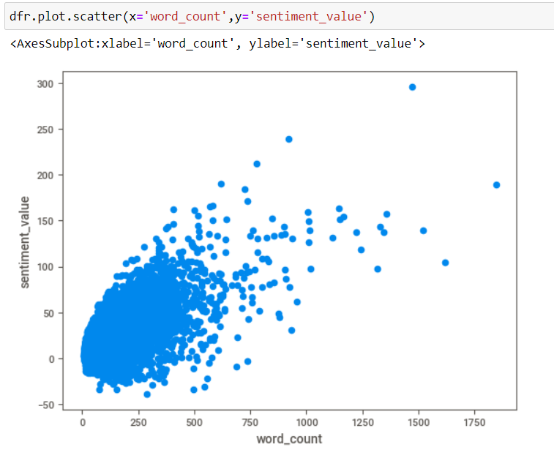
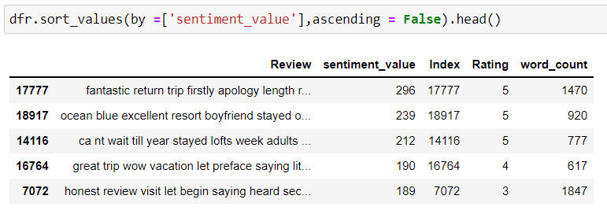
Agenda 2 – Model Building
Looking at the trend on Word count with sentiment value, we can infer that word count has a positive influence on the sentiment value

Slide 21
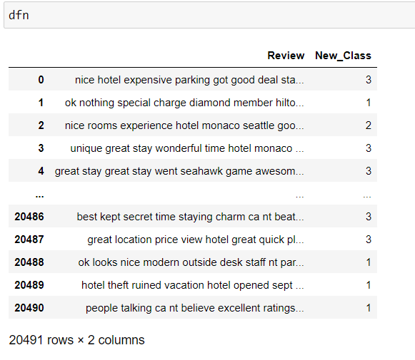
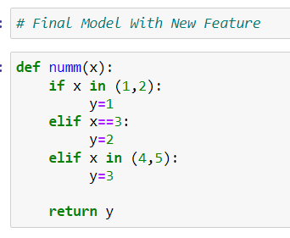
Agenda 2 – Model Building
We have introduced a new feature where the class or Y variable is reduced to 3 classes. ( 1 and 2 start as class 1, 3 start as class 2 and 4 and 5 star as class 3)

Slide 22
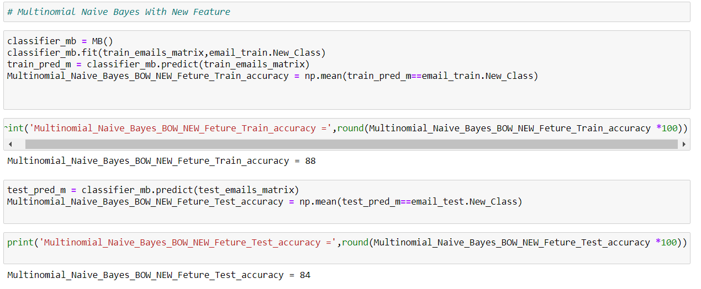
Agenda 2 – Model Building
Model 5 Multinomial Naive Bayes classification using BOW with New Feature
Train_accuracy – 88%
Test_accuracy – 84%

Slide 23
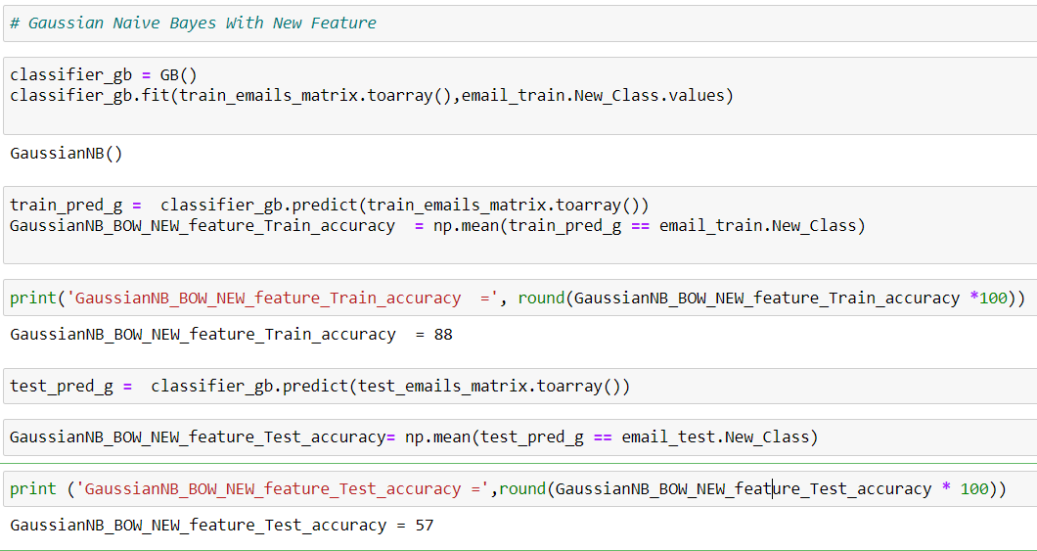
Agenda 2 – Model Building
Model 6 Gaussian Naive Bayes classification using BOW with New Feature
Train_accuracy – 88%
Test_accuracy – 57%

Slide 24
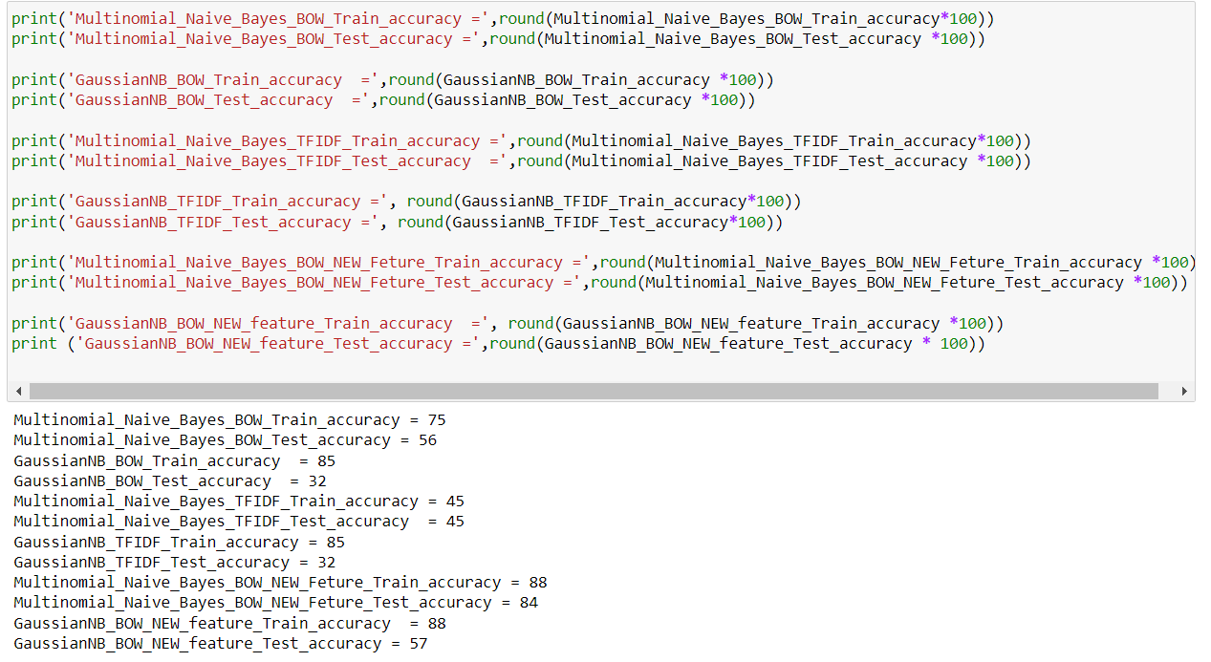
Agenda 2 – Model Building
Looking at the overall accuracy of all the model built we have finalized Model 5 Multinomial Naive Bayes classification using BOW with New Feature with 88 and 84 % accuracy

Slide 25
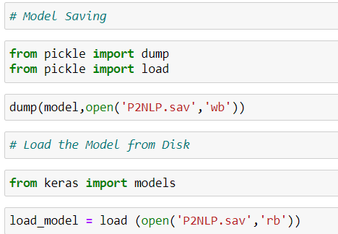
Agenda 3 – Model Deployment
Model Saving using Pickle

Slide 26
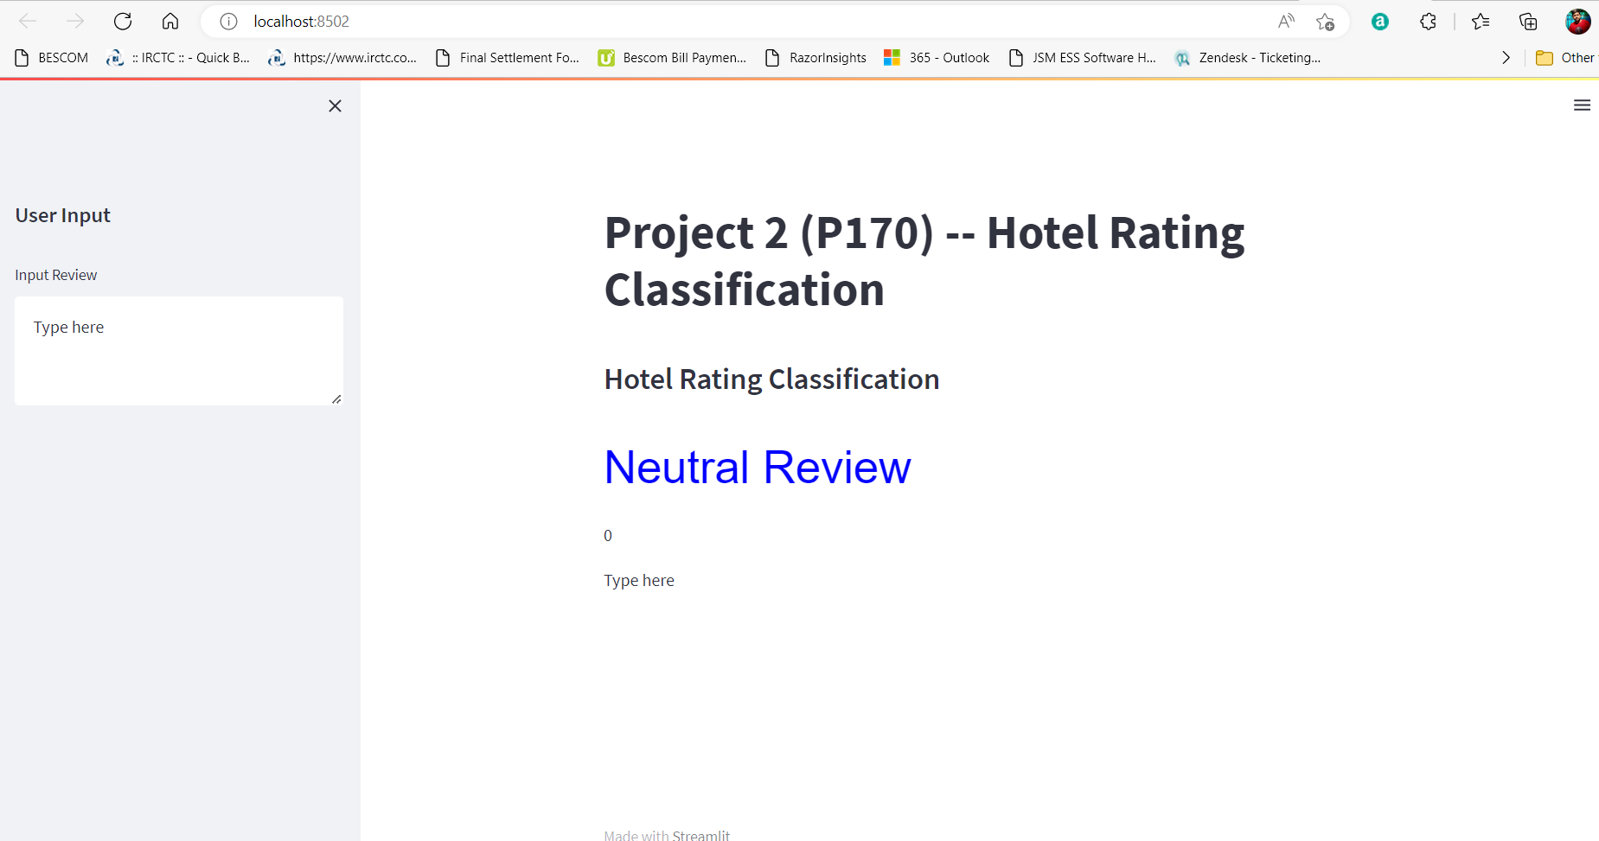
Agenda 3 – Model Deployment
Final Model 1 – Emotion Mining - Deployment
Where we have created an UI for user input text and the model gives the sentiment value and emotion associated.

Slide 27
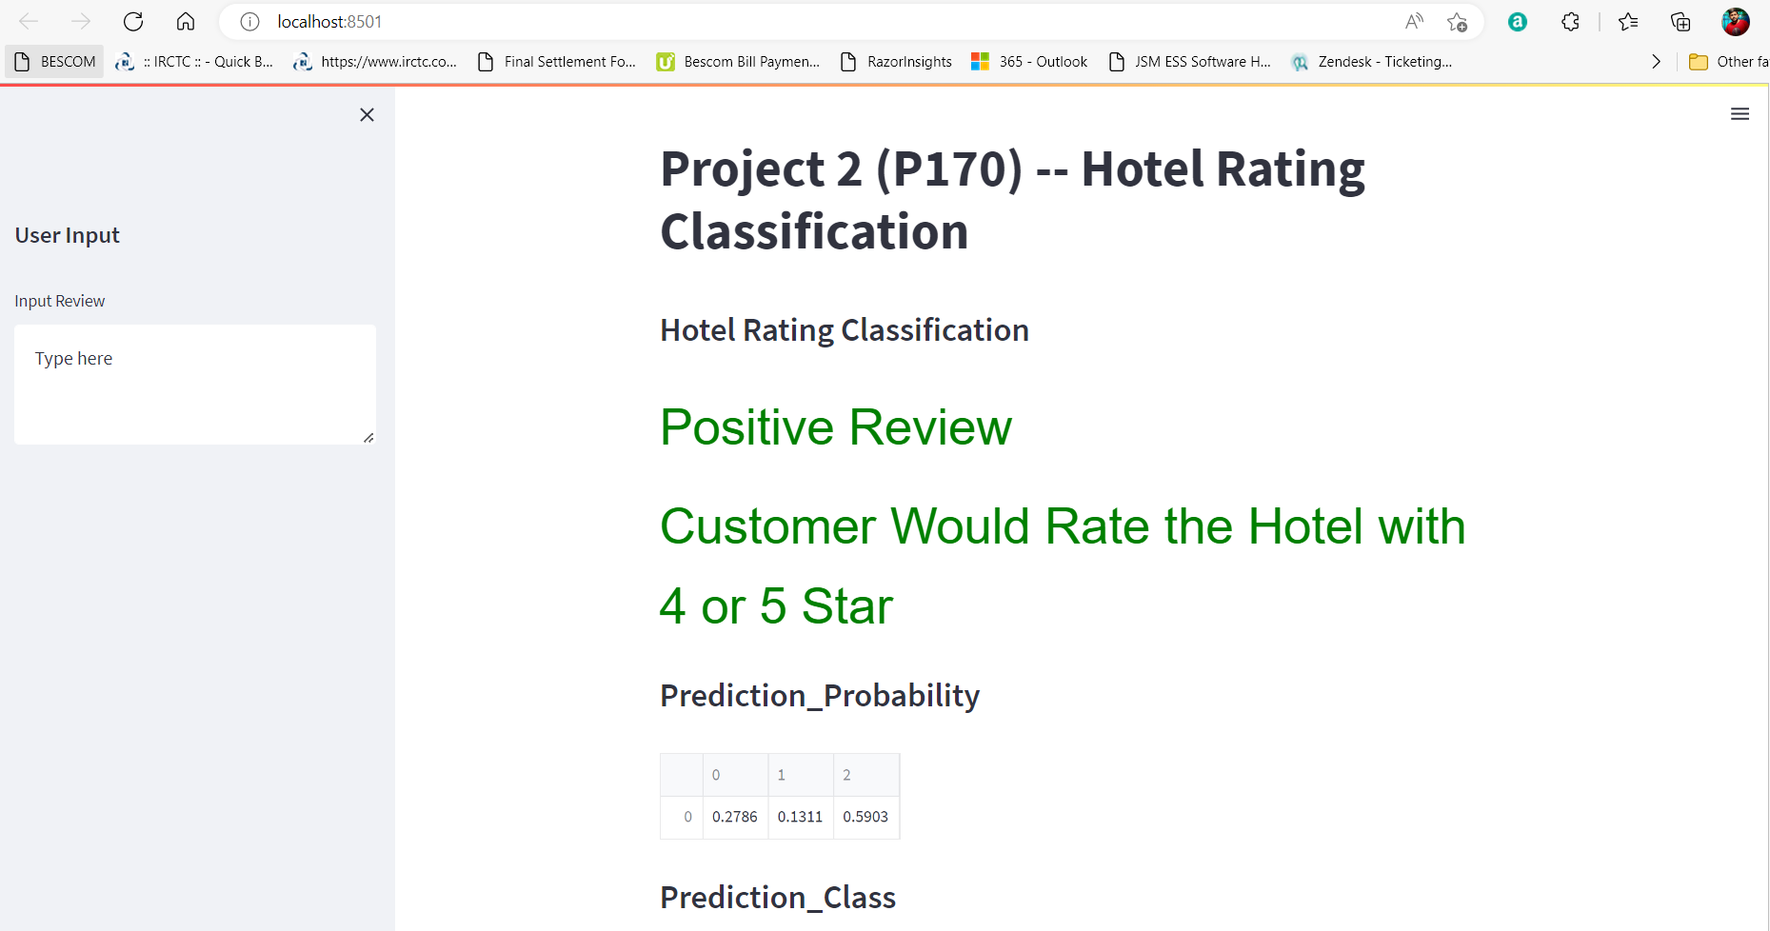
Agenda 3 – Model Deployment
Final Model 2 – Multinomial Naive Bayes classification - Deployment
Where we have created an UI for user review input and the model classifies it as positive / negative reviews with the rating and even the model gives the probability associated with all the 3 classes for the given review.

Slide 28
FINAL INFERENCE
Considering all the models build, we can say the data set for given Hotel is overall having a positive review and there are few things customers are happy with like Rooms, Breakfast, beach etc. which the hotel can try to maintain, so that they have the same kind of response for the upcoming customers too and there are few words frequent words mentioned by unhappy customers that the Hotel management need to concentrate like dirty, food, wait etc. which can improve the overall experience and reduce the number of unhappy customers at the Hotel.

Slide 29

THANK YOU

